Slide 1
Vision
Identify the cards on the table
Face Down cards
Face Up cards
Coordinates & Pose Estimation
Match the local coordinates to the world coordinates
Identify the features of the cards
Shape
Rectangle
Triangle
Filler
Shaded
Block
Ellipse
Not Shaded
No of Shapes
1
2
3

Slide 2
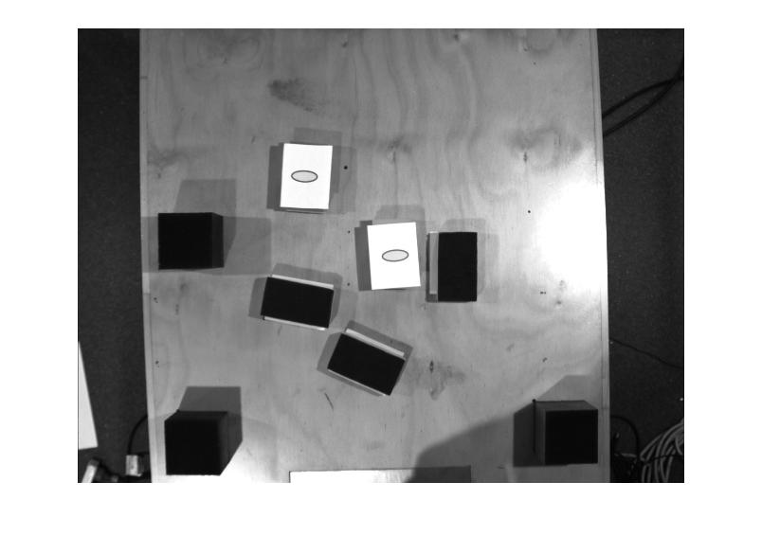
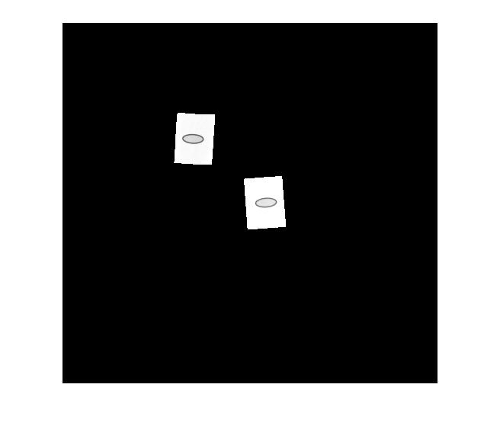
Identify the cards
Used basic histogram equalisation
Used pixel values as a threshold
Create a mask to isolate face up

Slide 3
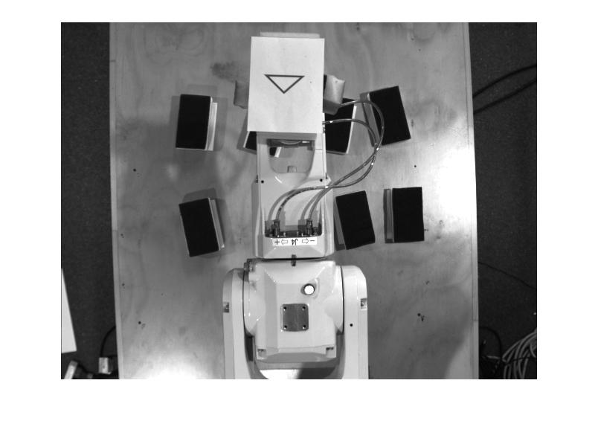
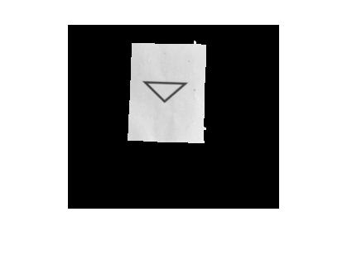
Identify the features of the cards
Create a mask using pixel values for white as a threshold
Extract only the card from the image using a mask and a bounding box

Slide 4
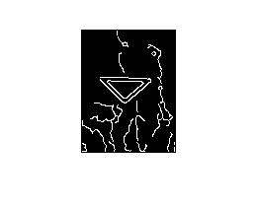
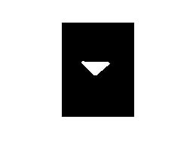
Identify the features of the cards
Detect edges using canny
Remove unnecessary edges from detected edges.
Extract the shape using perimeter value.
Used Mean Intensity for detect the filler status.

Slide 5
Motor Control
Combination of Epson Program Code and Matlab
Epson for basic motions
Matlab to implement more complicate motions
Move to centroid coordinates
Pick up and position card for imaging
Stack matching pairs

Slide 6
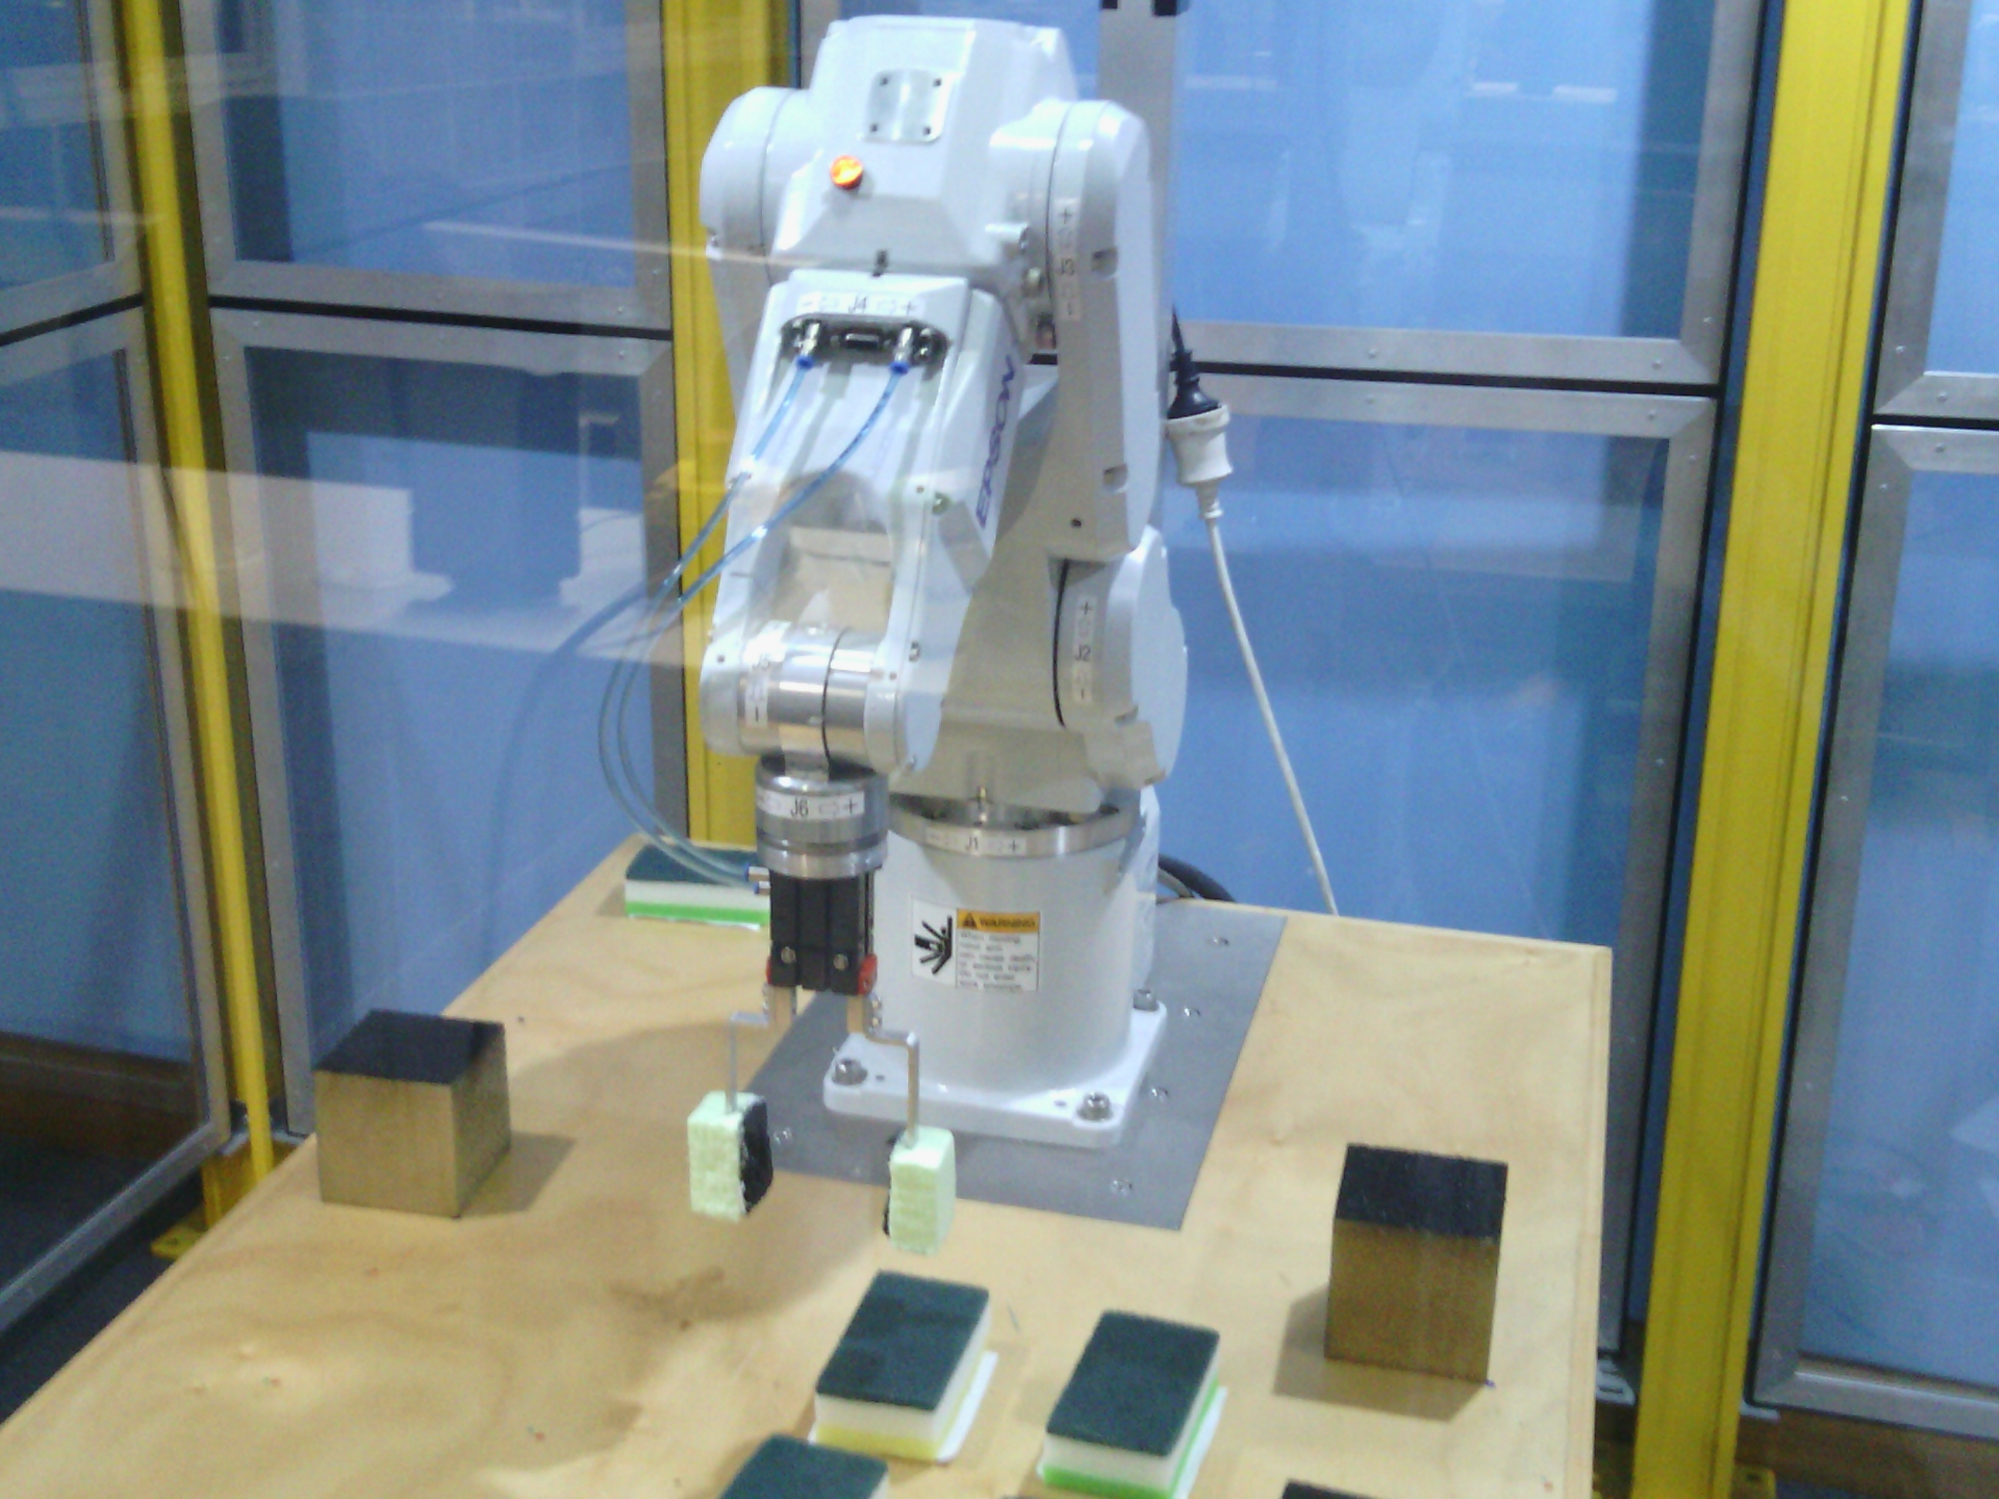
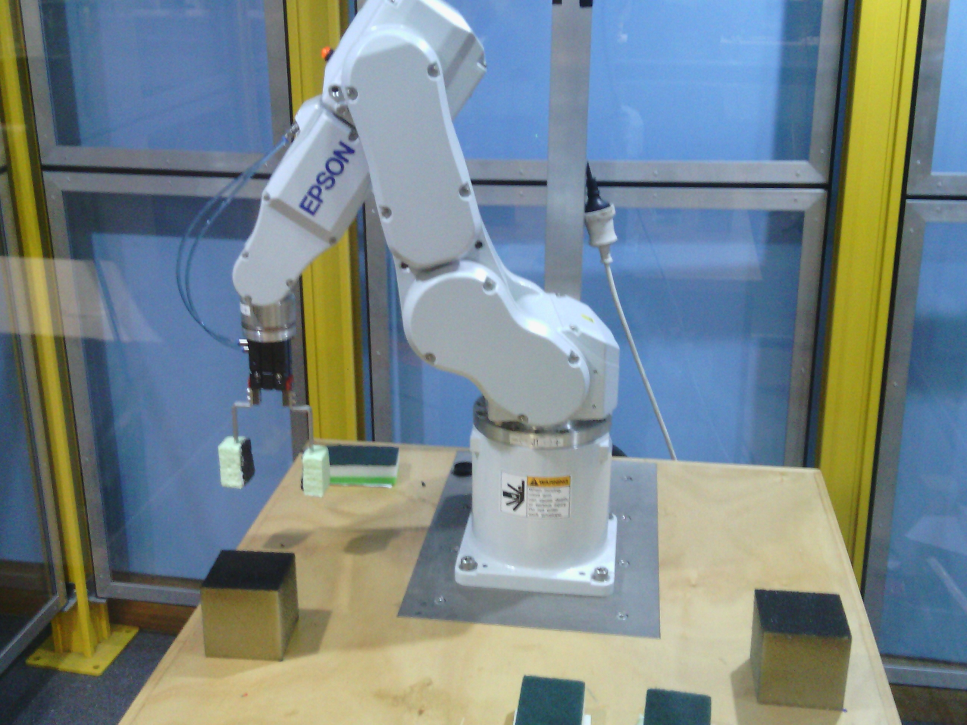
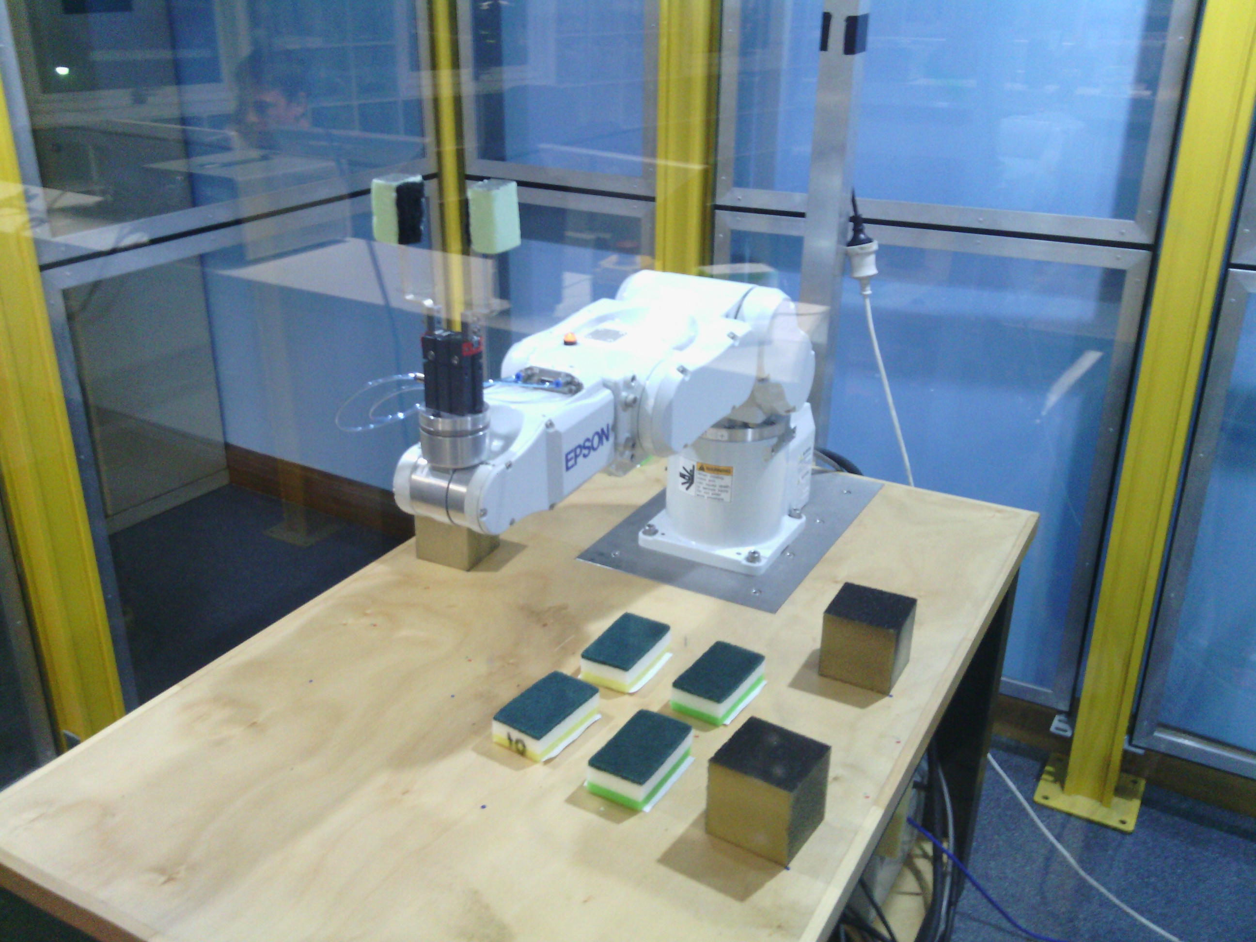
Movement Sequence
Certain actions had to have reversals
Hide Arm, Peek at Card
Returning to Home would result in illegal movements

